Slide 1
Predictive Modeling for
LILA Communities
Accenture Federal Services
April 15, 2022
Lauren Truong
Narottam JajodiA
SAGE Ramsammy
Nico Mora
Sathvik Ganta

Slide 2





Meet The Team
Lauren Truong
Narottam Jajodia
Sage Ramsammy
Sathvik Ganta
Nico Mora
DATA SCIENTIST
Data engineer
Data modeler
Data analyst
Domain expert

Slide 3


Low Income - Low Access (LILA) communities are areas with limited accessibility to viable, healthy food options.
Low Income
Low Access
Low-income status is determined by poverty rates (at least 20 percent) or median family income (at or below 80 percent of the metropolitan area or State median income) in each census tract.
Low-access status is determined by proximity to nearest store ranging from 1 mile in urban areas, and 20 with rural areas, as well as vehicle access.
Information from USDA ERS: https://www.ers.usda.gov/webdocs/publications/82101/eib165_summary.pdf?v=0

Slide 4
Business Objective
Issue
USDA defines LILA communities with Census Data every 5 to 10 years.
Objective
Predict LILA communities at a faster rate using researched data excluding information used to create the USDA LILA definition.
Project Outcomes
Identified Key Variables
‘Proportion of Households Units Using SNAP Benefits’
‘Property Value’
Created a Model with Accurate Predictions
Correctly identifies 78.5% of most recent LILA communities.
Found Insights From False Positives
Communities at potential risk and area for further research.
Low-Income, Low-Access (LILA) Community:
Area with limited accessibility to viable, healthy food options.

Slide 5


"In a country that wastes billions of pounds of food each year, it's almost shocking that anyone in America goes hungry. Yet every day, there are millions of children and adults who do not get the meals they need to thrive."
Feeding America
"The mission of USDA's Economic Research Service is to anticipate trends and emerging issues in agriculture, food, the environment, and rural America ... to inform and enhance public and private decision making."
USDA ERS

Slide 6

Modeling rational
Motivation
In total, 9.5% of census tracts experienced a classification change.
Classification changes can be positive or negative.
4,734
1,352
837
Communities change in
Low-Access classification
from 2015-2019.
Communities change in
Low-Income classification
from 2015-2019.
Communities change in
LILA classification
from 2015-2019.
Low-Income, Low-Access (LILA) Community:
Area with limited accessibility to viable, healthy food options.

Slide 7
Why should we predict LILA Communities vs. define?
In total, 9.5% of census tracts experienced a classification change.
There are between 1,200-8,000 people per census tract, so the impact of classification changes holds magnitude.
Through time, it becomes ambiguous if the USDA needs to begin, continue, and or end funding and assistance.
Model predicts 78.5% of these communities.
The model aids in closing the time gap between census counts and LILA information.
Increase capital allocation efficiency.
Drive impact to improve areas that need food and nutrition policies, as well as nutrition education.
Low-Income, Low-Access (LILA) Community:
Area with limited accessibility to viable, healthy food options.
Statistics found from USDA ERS Website: https://www.ers.usda.gov/amber-waves/2021/june/updated-food-access-research-atlas-now-maps-changes-in-low-income-and-low-supermarket-access-areas-in-2019/

Slide 8
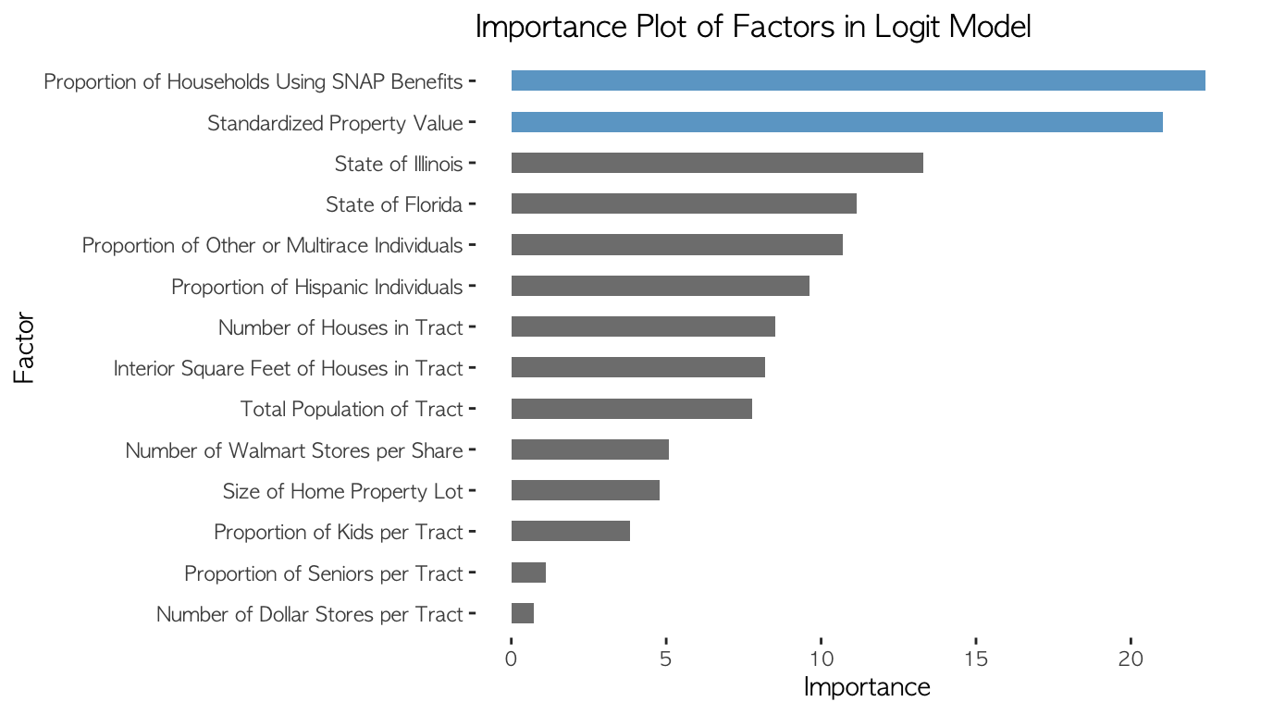
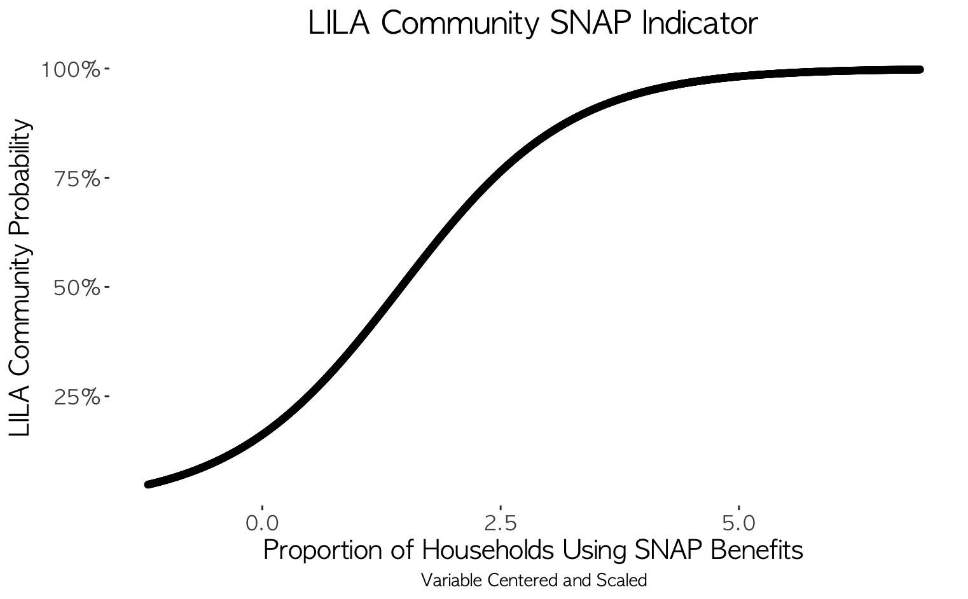
INSIGHTS
Key Variables
These identified key variables can be used to redefine the LILA definition created by the USDA, by using our insights on variables that are more readily available than the current definers.
The USDA can use our variables as a tool to closely monitor census tracts.
For instance, the graph below can be used with a threshold to alarm the USDA of a potential LILA community when surpassing a certain level.
threshold to notify agency
*Plotted variables are all statistically significant.
*‘Proportion of Households Using SNAP Benefits’ → Count of Households utilizing SNAP / Housing Units.
*‘Property Value’ → Average value of property per the FHFA.
Low-Income, Low-Access (LILA) Community:
Area with limited accessibility to viable, healthy food options.

Slide 9
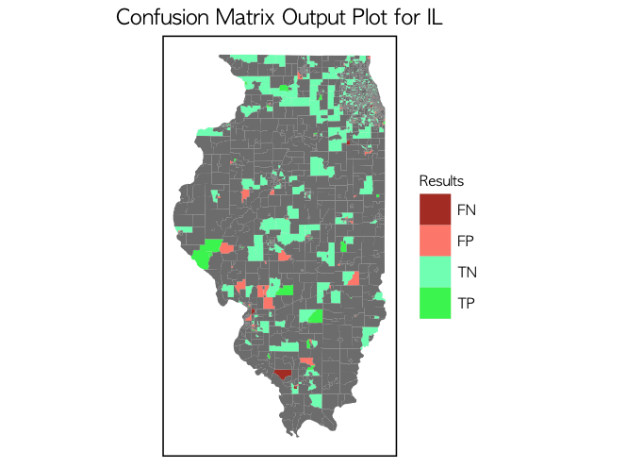
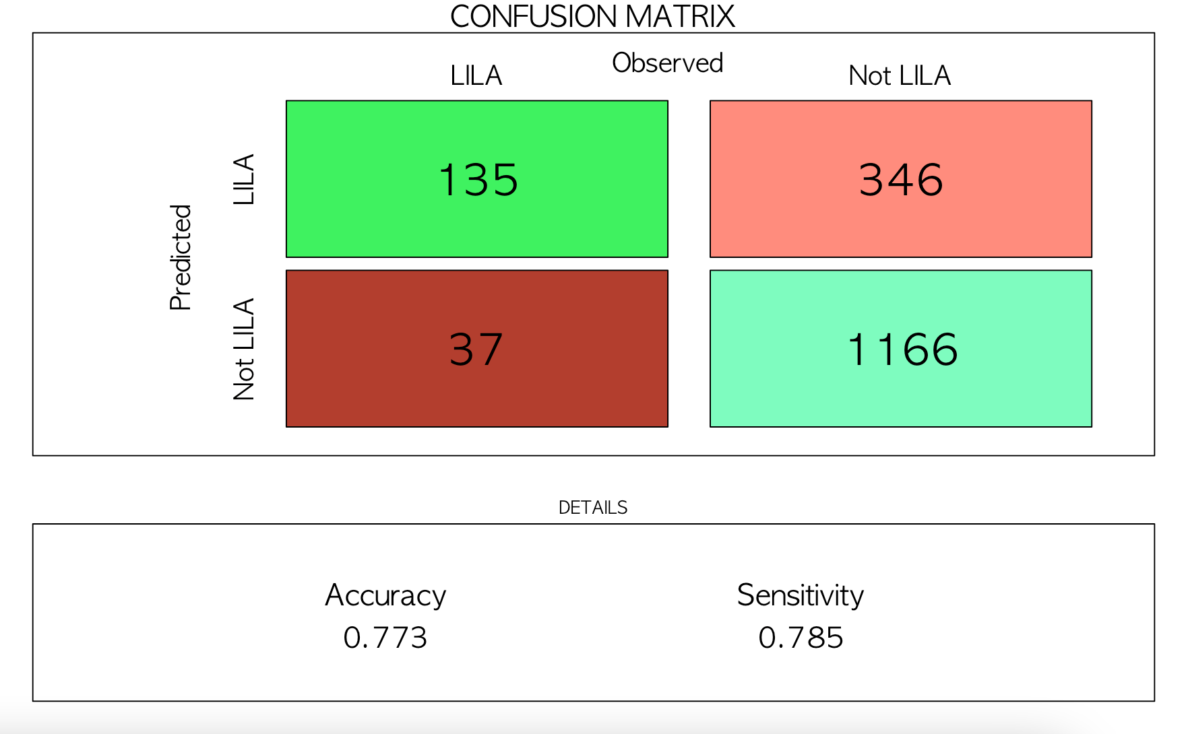
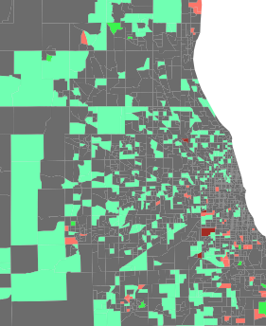
Question: Why does our model have an unusual amount of false positive classification errors? Can we discover something about these communities?
insights
Model Output
Logit model measures for predicting LILA communities:
Accuracy: Overall, how often is the classifier correct?
Sensitivity: When it predicts “LILA”, how often is it correct?
TRUE POSITIVE (TP)
FALSE POSITIVE (FP)
FALSE NEGATIVE (FN)
TRUE NEGATIVE (TN)
Low-Income, Low-Access (LILA) Community:
Area with limited accessibility to viable, healthy food options.

Slide 10
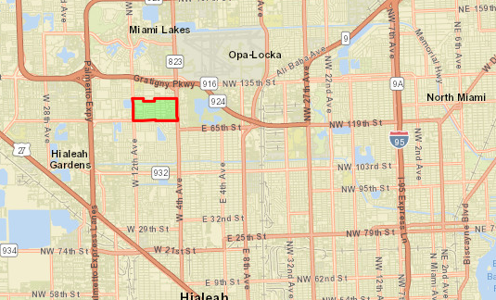
insights
False Positive Trending LILA:
Census Tract 93.08 - Hialeah, Florida
Low-Income
1
Median household income of approximately $29,000
51% lower than the median household income of $59,000 for the state of Florida.
2
Poverty Rate
County: Miami-Dade
State: Florida
Tract No: 12086009308
Percent of households below the poverty line is 33%
20% higher than the rate of 13% for the state of Florida.
3
Education
Percent of population with high school diplomas is 68%
20% lower than the rate of 88% for the state of Florida.
Low-Income, Low-Access (LILA) Community:
Area with limited accessibility to viable, healthy food options.
Statistics found from: https://opportunitydb.com/zones/12086009308/

Slide 11
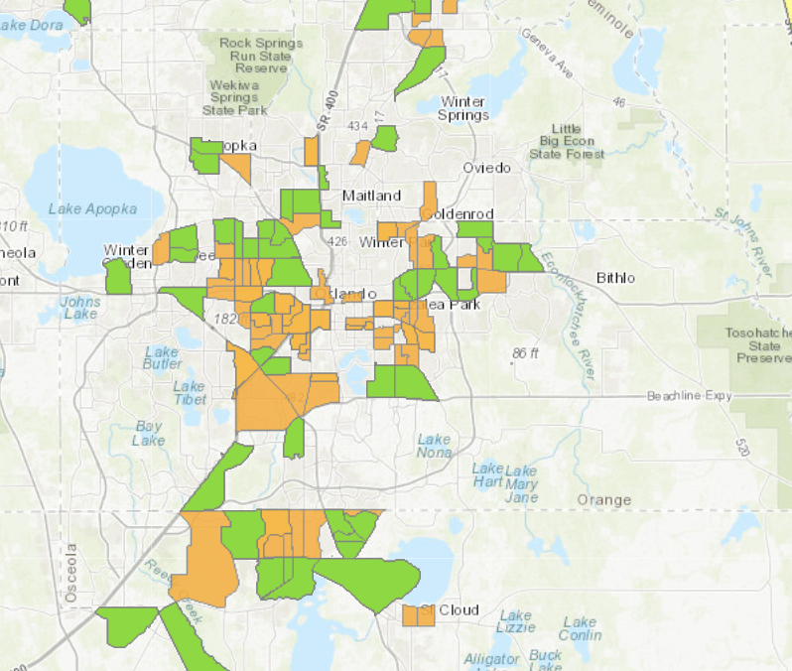
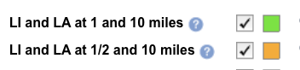
data collection replication
Challenges Leading to Growth
Census tract granularity makes data selective.
a. Need addresses or coordinates when selecting data.
Required web-scraping and geolocating.
b. Cannot scale data from county to census tract.
Made the team reluctant on federal data or web-scraping.
c. Difficulty in finding data within marginalized areas.
Required sub-setting data to remove NAs.
Joining datasets by Census Tracts
Census tract IDs are time sensitive (they change over time)
so collecting datasets required attentive data selection.
Source: https://www.ers.usda.gov/data-products/food-access-research-atlas/go-to-the-atlas/
Low-Income, Low-Access (LILA) Community:
Area with limited accessibility to viable, healthy food options.

Slide 12
Data collection replication
Requirements and Assumptions
Requirements
Dependence on census tract as the sole primary key for merging datasets.
Any new external dataset needs to be granular to the census tract level (or street address/ coordinates).
Web-scrape information from potential websites and geolocate to achieve data with the required granular primary key.
Assumptions
Leveraged the Perfect State Index by NPR to select the 3 states for modeling.
State rankings: Illinois #1, Florida #8, and Colorado #19.
Excluded NA values to reduce potential data bias from multivariate analysis.
Low-Income, Low-Access (LILA) Community:
Area with limited accessibility to viable, healthy food options.

Slide 13




DATA COLLECTION replication
Data Sources
USDA Food Access Research Atlas
Walmart.com – Store Finder
Dataset containing LILA Defined Census Tracts
Also includes housing units that utilize SNAP benefits, demographics (ex. Multiracial, Hispanic), and varying age groups (ex. Senior, Kid).
Web-scraped Walmart.com to pull US Walmart locations. Utilized each store’s address to geocode, tract their distance from census tracts, and count locations per census tracts.
American Community Survey Census Data
Federal Housing Finance Agency
Total Population and Housing Units variables were used to create proportions and normalize our variables.
Lot Size, Property Value, and Interior Square Feet variables were utilized to predict Low-Income census tracts.
Low-Income, Low-Access (LILA) Community:
Area with limited accessibility to viable, healthy food options.

Slide 14
Summary
1
Reduce LILA Definition Dependence
The 10-year information gap between Census Decennials can be reduced by utilizing additional variables.
‘Proportion of Households Units Using SNAP Benefits’
2
Predictions and Insights from Modeling
Our machine learning model correctly predicts LILA communities with 78.5% accuracy.
Updated lists of LILA communities can be produced at a faster rate than current methods.
Can analyze outputs to find trending LILA communities.
Low-Income, Low-Access (LILA) Community:
Area with limited accessibility to viable, healthy food options.

Slide 15
Summary
3
Modeling Next Steps
Create a new variable that measures units of advantage or disadvantage for a community based on all other variables.
Split modeling into LI and LA and find a method to properly combine models.
4
Future Opportunity
This project creates opportunities for new tools/methodologies to be created within the agency.
A dashboard available to the public that displays updated mappings of LILA communities.
New methodologies to identify LILA communities that can be implemented in different USDA division or for a new LILA definition.
Low-Income, Low-Access (LILA) Community:
Area with limited accessibility to viable, healthy food options.

Slide 16

Thank You!
Questions?

Slide 17
Appendix
Different Modeling Approaches...................slide 18
Model Output Plot FL.....................................slide 19
Model Output Plot CO...................................slide 20
Model Output Plot IL......................................slide 21
Model Output Histograms.............................slide 22
Model Output Box Plots................................slide 23
Works Cited......................................................slide 24

Slide 18
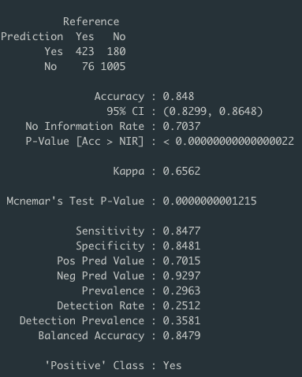
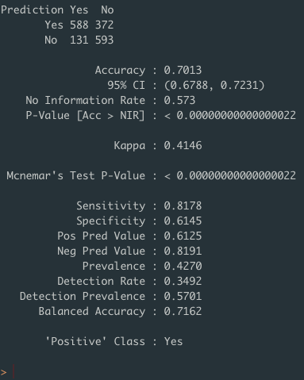
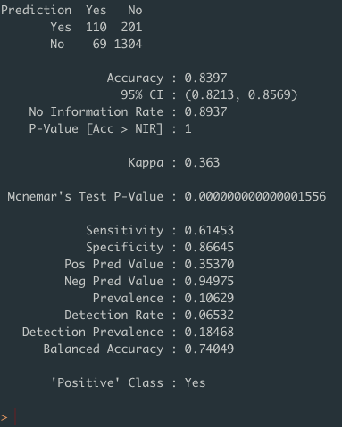
Different Modeling Approach
Low Income & Low Access Model Outputs Combined
Low Income Model
Low Access Model

Slide 19
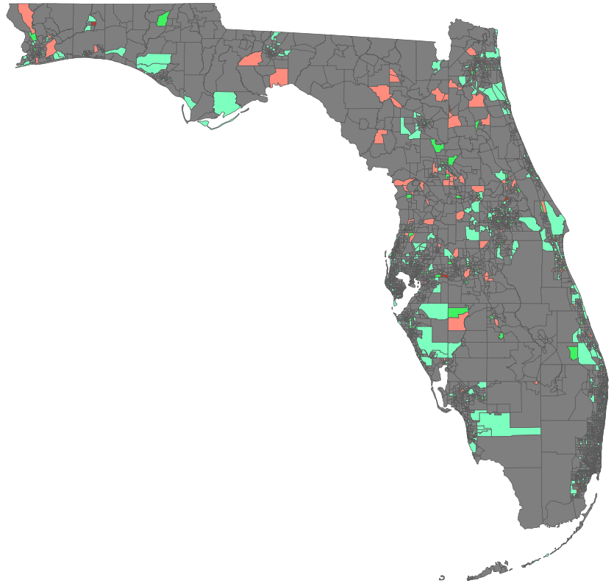
Model Output
Plots

Slide 20
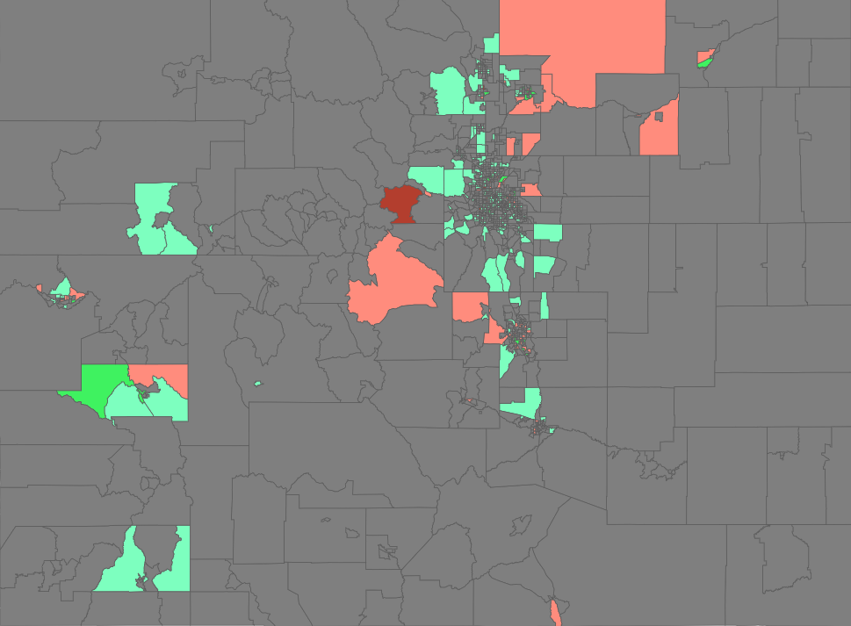
Model Output
Plots

Slide 21
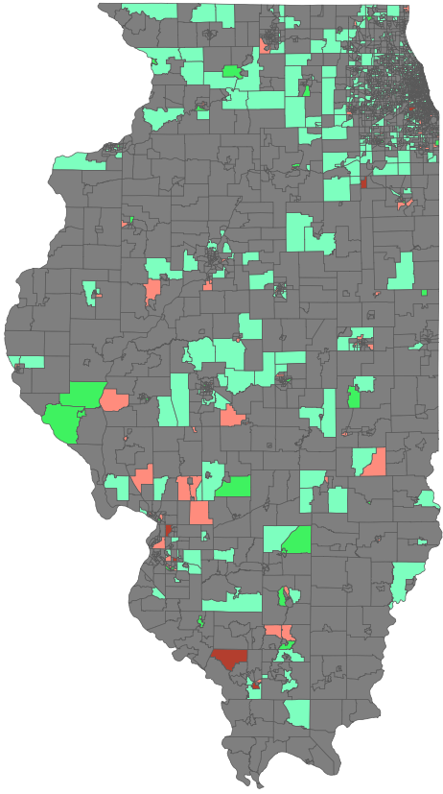
Model Output
Plots

Slide 22
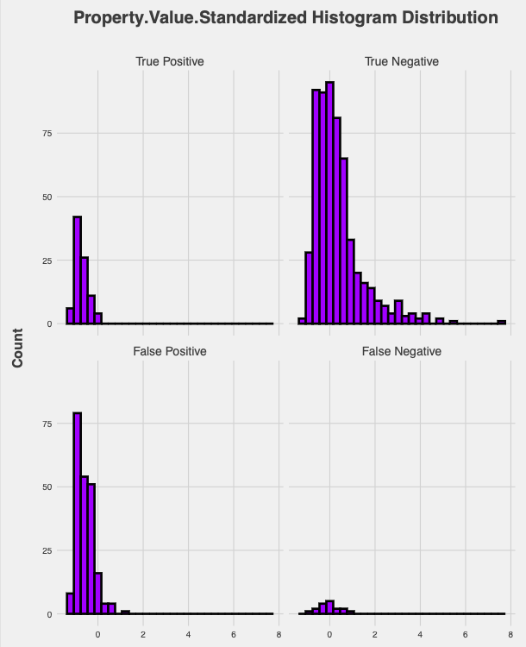
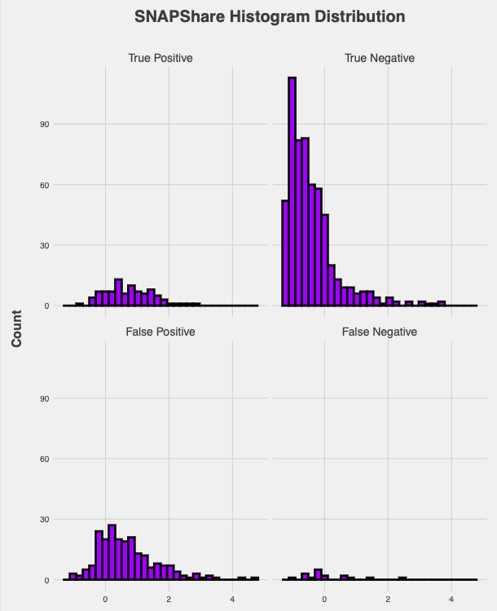
Model Output Histograms

Slide 23
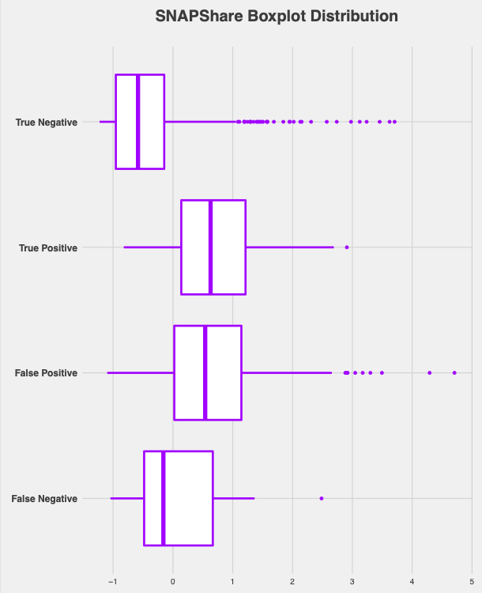
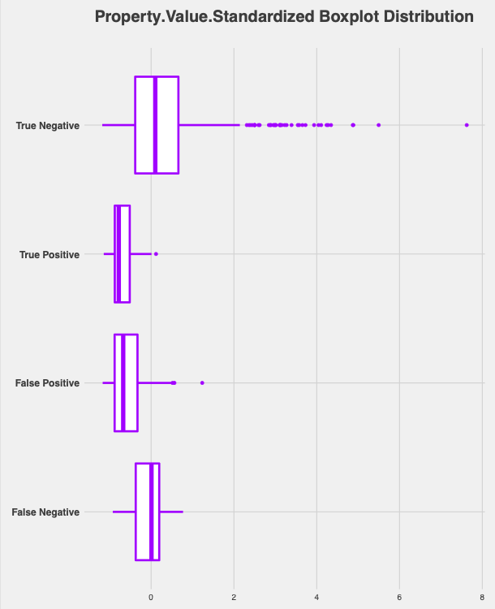
Model Output Box Plots

Slide 24
Works Cited
Dubowitz, Tamara, et al. “A Natural Experiment Opportunity in Two Low-Income Urban Food Desert Communities: Research Design, Community Engagement Methods, and Baseline Results.” Health Education & Behavior, vol. 42, Sage Publications, Inc., 2015, pp. 87S-96S, http://www.jstor.org/stable/45088244.
Lee, Sung-jin, et al. “Exploring Housing Challenges of Low-Income Minority Populations in the Southern United States.” Cityscape, vol. 14, no. 1, US Department of Housing and Urban Development, 2012, pp. 73–98, http://www.jstor.org/stable/41553082.

